Slide 1
All Faculty & Staff Meeting
Thursday, September 12, 2024

Slide 2
Welcome, Updates, and Recognition
President Abousalem

Slide 3
Welcome New Faculty & Staff
President Abousalem

Slide 4
Welcome New Staff & Faculty!
Dan Montplaisir, Vice President of Advancement– Hired: 9/01/2024

Slide 5
Welcome New Faculty & Staff
Megan Prosser, Provost and Vice President of Academic Affairs

Slide 6
Welcome New Staff & Faculty!
Maria Simanjuntak, Data Analyst – Hired: 7/15/2024
Yian Chen, Assistant Professor of Bioprocessing – Hired: 8/01/2024
Christine Ashikyan, Director, Office of Research and Sponsored Projects – Hired 8/12/2024
Solomon Iyasere, Director of Corporate Partnerships – Hired 8/19/2024
Lohini Reddy Gangireddy, Administrative Assistant, Office of Experiential Education – Hired: 8/19/2024
Marisa Torres, Administrative Coordinator – Hired: 8/20/2024
Puja Patel, Assistant Professor, Clinical Sciences– Hired 9/01/2024
Jungyeon Moon, Assistant Professor, Clinical Sciences– Hired: 9/01/2024

Slide 7
Welcome New Faculty & Staff
Matt Madrid, Vice President of Admissions and Enrollment Management

Slide 8
Welcome New Staff & Faculty!
Peter Lujan, Director of Admissions – Hired: 9/03/2024

Slide 9
Academic Affairs
Megan Prosser, Provost and Vice President of Academic Affairs

Slide 10
Title IX
Shino Simons, Dean of Students

Slide 11
HEDS Survey
Josh Morris, AVP of Educational Effectiveness and Faculty Development

Slide 12

About the HEDS Diversity and Equity Campus Climate Survey
Administered by the Higher Education Data Sharing Consortium
The HEDS Diversity and Equity Campus Climate Survey asks students, faculty, staff, and administrators about their:
- perceptions of their institution’s climate
- perceptions of how their institution supports diversity and equity
  - experiences with discrimination and harassment at their institution
Provides Normed Results

Slide 13
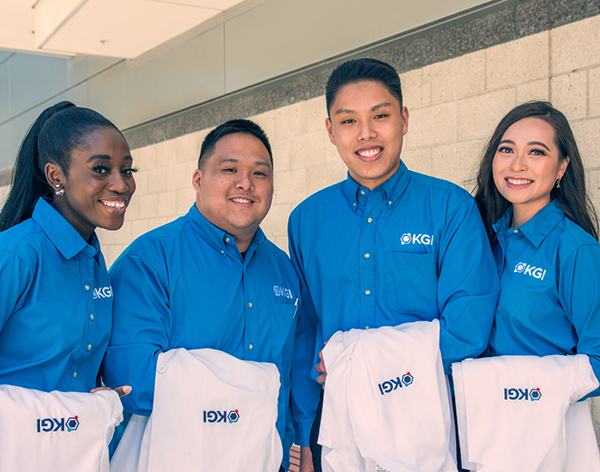
KGI Demographics Overview
115 Responses (16% Response Rate)
- 2 Undergraduate Students
70 Graduate Students
13 Faculty
23 Staff/Administrators

Slide 14
KGI Demographics Overview

Slide 15
KGI Demographics Overview

Slide 16
KGI Demographics Overview

Slide 17
KGI Campus Climate

Slide 18
KGI Campus Climate

Slide 19
KGI Campus Climate

Slide 20
KGI Campus Climate

Slide 21
KGI Campus Climate

Slide 22
KGI Campus Climate

Slide 23
KGI Campus Climate

Slide 24
DEI Strategic Planning Process
August 26: HEDS Survey Data review with JEDI Committee
September 12: Presentation to Faculty and Staff Meeting
September – October
  Present data to Student Government
  Email communication to the entire community (data and planning process)
Focus Groups (students, faculty, staff, JEDI)
  October – December: Impressions of the data and key takeaways
  January – March: themes/strategies
  April – May: Draft strategic plan
June: Final DEI strategic plan communicated

Slide 25
JEDI Committee Updates
Jeniffer Hernandez, Associate Professor of Biopharmaceutical Sciences, School of Pharmacy
Elizabeth Emerald, Alumni Engagement Officer

Slide 26
JEDI Membership
Jeniffer Hernandez (Co-Chair) Associate Professor of Biopharmaceutical Sciences, School of Pharmacy
Emily Quinn (Co-Chair) Program Director for the Human Genetics and Genetic Counseling (MSCM) Program & Assistant Professor, School of Health Sciences
Elizabeth Emerald (Co-Chair) Alumni Engagement Officer, Advancement & Alumni Support
Barbara Bailus Assistant Professor of Genetics, (MSGDA) Riggs School of Applied Life Sciences
Ijeoma Chikezie Student Government Diversity Chair
Christy Eskes Program Director of Master in Physician Associate Studies (MSPA)
Cesar Espinoza Associate Professor of Bioinformatics and Data Analysis, Riggs School of Applied Life Sciences (MSGDA)
Anastasia Levitin Program Director for Master of Sciences of Riggs Applied Life Sciences (MS)
Kirstin Lopez Student Affairs Coordinator
Jennifer Rangel Registrar
Ana Sanchez Assistant Professor of Occupational Therapy, School of Health Sciences (OTD)
Lisa Trahan Grants and Contracts Coordinator
Notes:
New and returning faculty and staff are welcome to join. We are especially looking for representatives from admissions and HR.

Slide 27
Vision:
Keck Graduate Institute strives to address, explore, educate, understand, and respond to the diversity of the human experience.
The JEDI Committee will be a thought-partner to foster open and transparent communication with KGI’s senior leadership by working to promote strategic priorities related to justice, equity, diversity, and inclusion issues.
KGI is an educational community which values, recognizes, and embraces diversity among our students, staff, and faculty. It seeks to provide an inclusive learning and research environment where each person feels a sense of belonging and respect.
Mission:
The JEDI Committee works to integrate best practices for justice, equity, diversity, and inclusion into intuitional values, policies, and programs. The JEDI Committee will provide research and policy recommendations, event support, and guidance to KGI’s leadership as requested.

Slide 28
Committees
Inclusive Culture
  Diversity and Inclusion Toolkits
  Trainings and Workshops
Student Collaborations/Events
  Holidays and community celebrations
  When and how to partner with Student Affairs and Student Government
Funding
  Grants and Sponsorships
Notes:
Students invited to join meetings and committees. Email JEDI
Committees we plan to have. So if someone wants to serve on a committee, they are welcome to assist.

Slide 29
Committees
Website
  Update website with committee, goals, develop resources
Admissions
  Identify trends
  Opportunities to highlight JEDI principles in recruiting
Faculty and Staff
  Connecting with faculty and staff – what justice, equity, diversity, and inclusion activities are in the curriculum?

Slide 30
Events
Hosted by the Queer Resource Center - Foundational Allyship - Tuesday, September 17 | 10:00-11:30am
  Honnold Mudd Founder’s Room
  Email qrc@claremont.edu
Hispanic Heritage Month Celebration – Date September TBD
  In partnership with LMSA and Student Government
  Food drive during event
Hosted by the Queer Resource Center - Allyship in Action - Wednesday, October 16 | 1:00-2:30pm
  McAlister Center Multicultural Room
  Email qrc@claremont.edu
World Food Day – October 16th
  Additional Opportunity to fill food pantry
Lunar New Year Market - Spring

Slide 31
Food Pantry Items
Housed in Student Affairs Room 108
Requesting (Preference is for box items instead of cans):
Cereal (individual bowls or boxes)
Breakfast bars
Granola bars
Snacks
Pasta
Alfredo/marinara sauce
Rice
Canned tuna
Spam
Kitchen Utensils
Any items to make full meals
Please refrain from donating the following items as we have sufficient supplies:
Black beans
Pinto beans
Corn
Green beans
Donations can be dropped off with Kirstin Lopez in the Student Affairs office (Room 115)
Notes:
Food Pantry is in Student Affairs Room 108

Slide 32
Want to get involved?
Email JEDI@kgi.edu to find out how.
Thank you

Slide 33
Human Resources Updates
Cheryl Merritt, Assistant Vice President and Chief Human Resources Officer
Human Resources

Slide 34
Dining at the Claremont Colleges
Cheryl Merritt, Assistant Vice President and Chief Human Resources Officer
Human Resources

Slide 35

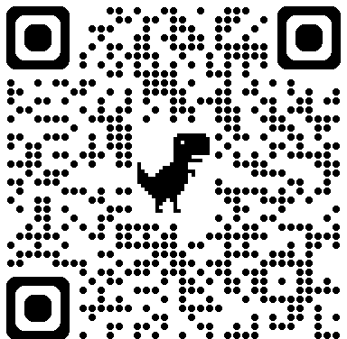

The Claremont Colleges Dining Halls
  Claremont Mckenna
    Collins Dining Hall
  Harvey Mudd
    Hoch-Shanahan Dining Commons (The Hoch)
  Pitzer
    McConnell Bistro Dining Hall
  Pomona
    Frank Dining Hall
    Frary Dining Hall
    Oldenborg Dining Hall
  Scripps
    Malott Commons
Scan the QR code to browse the daily menus of each dining hall.
https://menu.jojodmo.com/

Slide 36
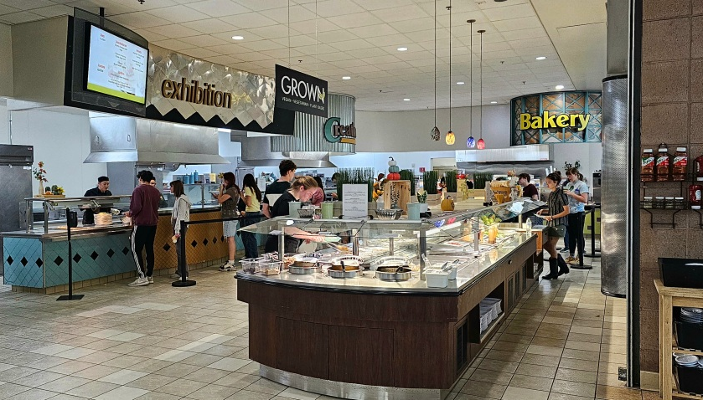
KGI Faculty and Staff Pricing
Breakfast: $8.75
Lunch: $10.50
Dinner: $12.25

Slide 37
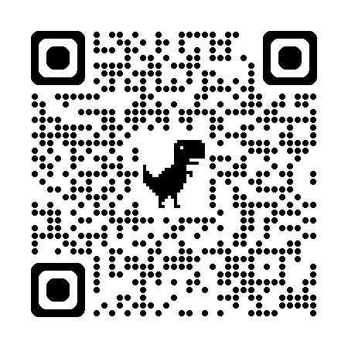
Payment Options
Credit Card
  Accepted at CMC, HMC, Pitzer, and Scripps
Claremont Cash
  Accepted at ALL dining halls.
  The ONLY payment option at the Pomona dining halls
  Loading funds onto your KGI ID card.
    Online (to login, please use your single sign-on information)
    In person at the Connection, and Frank or Frary Dining Halls
  Requesting Reimbursement on Loaded Funds
    Complete Claremont Cash Reimbursement Form and return the form to the Connection connection@cuc.claremont.edu
Scan the QR code to login and load funds into your account for Claremont Cash
https://tcc-sp.transactcampus.com/eAccounts/AnonymousHome.aspx

Slide 38

Upcoming Human Resources
Activities & Trainings
Great Shakeout 2024 – October 17, 2024
Recruitment & Onboarding Training – October 29, 2024
Spooktacular Coffee and Treats with the President – October 31, 2024
TIAA One on One Consultations – November 6, 2024
All Faculty & Staff Meeting, featuring "Pie on KGI", Service Awards, and a provided lunch – November 21, 2024
Holiday Food Truck & Dessert Event – December 11, 2024

Slide 39

Open Enrollment 2024
We would like to inform you that Open Enrollment will take place from October 14, 2024, to November 1, 2024. To help provide an overview and answer any questions, we will be hosting two Lunch & Learn sessions for the community.
The Lunch & Learn sessions will be held on the
following dates in building 517 Founders Room 165:
Tuesday, October 15, from 12:00 PM to 1:00 PM
Monday, October 21, from 12:00 PM to 1:00 PM

Slide 40
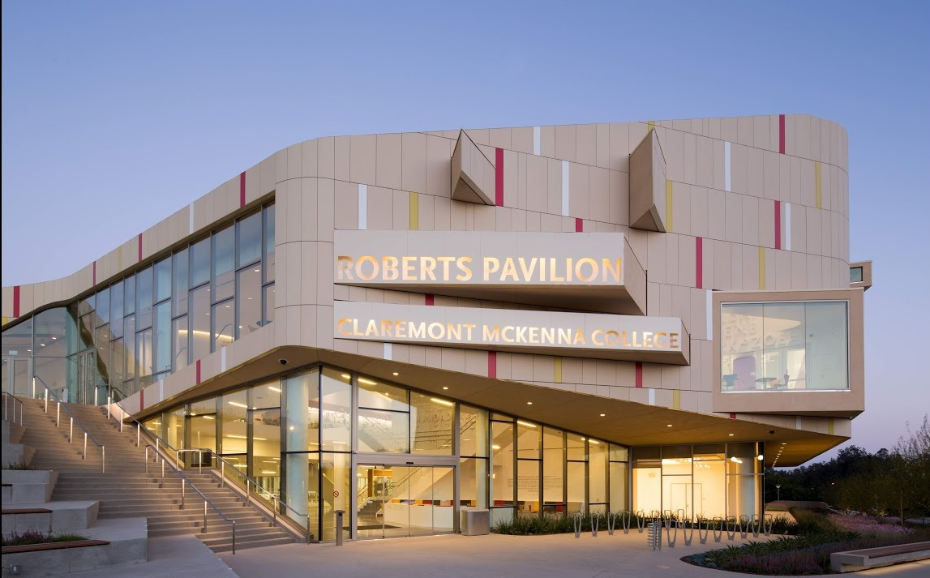
Open Enrollment 2024
The Claremont Colleges Services Health Fair
We are pleased to announce that TCCS will be hosting a Health Fair.
The event will take place on Wednesday, October 23, 2024, from 10:00 AM to 2:00 PM at Claremont McKenna College, Roberts Pavilion.
This is a great opportunity to learn more about the various benefits and wellness programs available to you. We encourage all employees to attend and take advantage of the resources that will be shared.

Slide 41
Advancement &
Alumni Engagement
Dan Montplaisir, Vice President of Advancement

Slide 42

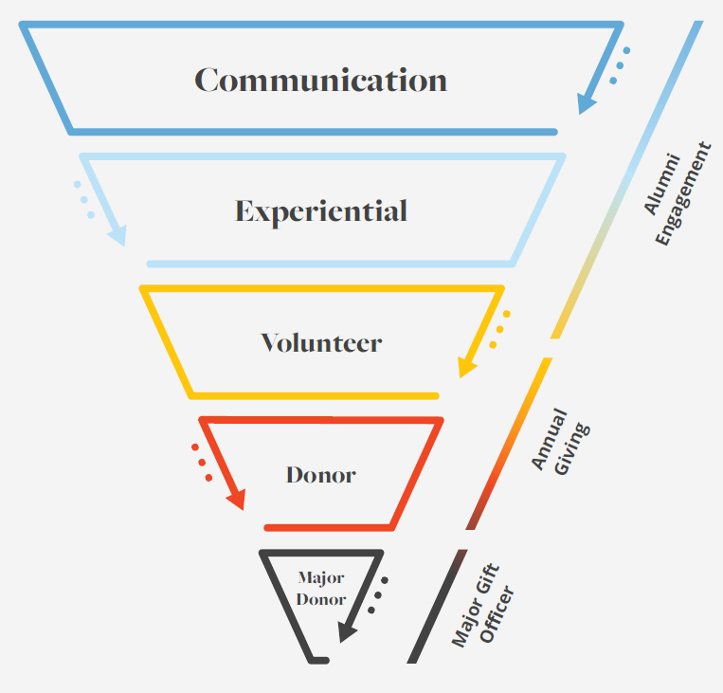




Framework for Advancement
KGI

Slide 43
Defining the Engagement Strategy
Communication | Volunteer
interactive, meaningful and informative communication that supports the institution mission, strategic goals and reputation | Formally defined and rewarding, volunteer roles that are endorsed by and valued by the institution
Experiential | Philanthropic
Meaningful experiences that inspire alumni and donors, valued by the institution, promote its brand, celebrate our achievements and strengthen the reputation | Financial support that is meaningful to the donor and supports the institutions mission
KGI

Slide 44
Alumni Engagement
  163 Alumni Volunteers
  901 Total Alumni Volunteer Hours
Notes:
How alumni are volunteering
Admissions – admission ambassadors or speaking to universities to recruit
Advisory Council – serving on advisory councils (Alumni, CRB now BIAB, ABCAB, etc.)
Career Services recruiter- attending events with career services to recruit new students
Class/Club/Event Speaker – speakers
Club Services – volunteer in service with clubs
Mentoring/Coaching – example – scholarship recipients mentored by members at organizations
Other – reunion volunteer
Preceptor – preceptors
Social content creation – taking photos with Beaker and sending them in to be posted or being in videos for social media

Slide 45
Alumni Giving and Engagement
Year | FY22 | FY23 | FY24
Total Alumni | 2111 | 2333 | 2550
Engaged Alumni | 318 | 332 | 379
Percentage of Alumni Engaged | 15% | 14.2% | 14.8%
Total Alumni Giving | $31,269 | $55,729 | $34,864
Notes:
Engaged alumni is defined as having either attended an event or a volunteer for a department on campus. Essentially, the alum gave us at least 1 hour of their time for the year.

Slide 46
Total Giving
Year | FY22 | FY23 | FY24
Total Donors | 222 | 221 | 154
Total Dollars Raised | $4,894,000 | $5,713,000 | $3,831,000
Notes:
Engaged alumni is defined as having either attended an event or a volunteer for a department on campus. Essentially, the alum gave us at least 1 hour of their time for the year.

Slide 47
Culture of Philanthropy
Shared Values
Gratitude & Recognition
Transparency & Accountability
Engagement & Involvement
Commitment of Leadership Team
Storytelling
Stewardship
KGI

Slide 48
Admissions & Enrollment Update
Matt Madrid, Vice President of Admissions and Enrollment Management

Slide 49
Fall 2024 Admissions
Program | 2024 Final
PharmD | 34
MSGC | 20
MSPA | 40
OTD | 14
MBS | 20
MENG | 11
MS | 29
MCHA | 17
MSGDA | 14
MSMDE | 9
PhD | 10
PPA | 10
PPC | 21
MBM | 1
CBM | 3
Total | 253
New Student Enrollment
  Over 250 New Students: +8% vs. 2023
    Riggs School of Applied Life Science: +17%
      Program with growth:
        MSMDE: +200%
        PhD: +100%
        PPA: +100%
        MCHA: +70% vs. MSCM
        PPC: +17%
        MBS: +11%
        MSGDA: +8%
    School of Pharmacy: +3%
    School of Health Sciences: -4%
  Total Applications Submitted: +8%
    MSPA: +17%
  Growth Challenges:
    MEng and OTD

Slide 50
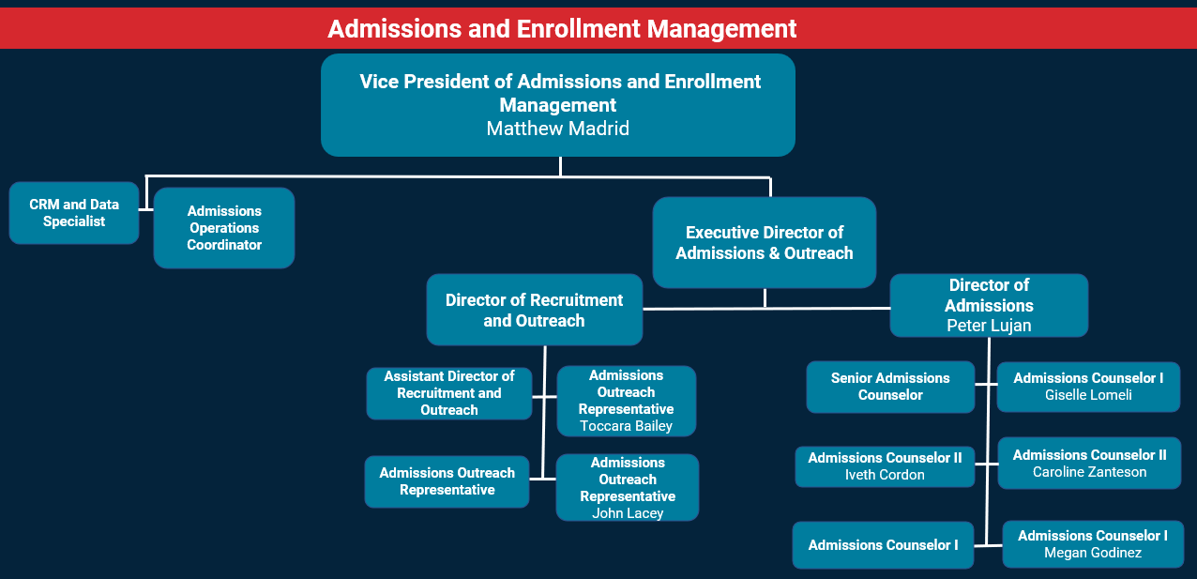
24-25 Staffing Update

Slide 51
24-25 High Level Priorities
Spring 2025 New Student Start
  MS, MBS, MCHA and MBM
Renewed International Focus
Prospect and Applicant Experience
  Process Improvements
  Increased Engagement
  Technology
Targeted Marketing and Outreach Strategy
Increase on-campus and virtual events
MSPA Pathway Program

Slide 52
Questions?

Slide 53
Welcome Back Raffle
Cheryl Merritt, Assistant Vice President and Chief Human Resources Officer
Human Resources

Slide 54

Thank you

