Slide 1

How to Complete an Annual Self-Evaluation in
Workday
Presented By:
Human Resources

Slide 2
Objectives
Overview: Performance Evaluation Process in Workday
Review of Competencies & Performance Ratings
Introduction to the NEW Annual Faculty Performance Self-Evaluation
Workday Demonstration:
  How to access, complete, and submit your self-evaluation.
Q & A

Slide 3

Important Dates To Remember
Review Period is based on a 7/1/2020 through 6/30/2021 period.
Self-Evaluations will be launched in Workday on Monday, May 24 to all Faculty.
Self-Evaluations to be submitted to Supervisors by Friday, June 11.
Performance Evaluations to be completed and communicated to faculty by Wednesday, June 30.

Slide 4
Preparing for your Self-Evaluation
Gather last year’s Annual Evaluation documents:
  Annual Activities Report (2019-20)
  Annual Self Evaluation (2019-20)
  Annual Performance Evaluation (2019-20)
Prepare Annual Activities Report for this review period (2020-21)

Slide 5
Performance Evaluation Ratings
HIGHLY EFFECTIVE | Contributions and high quality of work are widely recognized. The majority of performance outcomes routinely and consistently exceed defined expectations, producing important and impactful results for the Institute through planning, execution and creativity. Projects and objectives are completed in a manner that expands the scope and impact of the assignment.
SUCCESSFUL AND EFFECTIVE | Successful in performing the majority of job responsibilities and making a solid, reliable and meaningful contribution to the Institute. Performance is competent, efficient and effective along established expectations. Initiative, resourcefulness and good judgment are consistently exercised.
SOME IMPROVEMENT REQUIRED/SOME SUCCESS | Performance is effective in some areas, there are other areas in which performance is inconsistent or falls below established expectations.
SIGNIFICANT IMPROVEMENT REQUIRED | Performance is not acceptable in critical areas of the job and falls below minimum expectations. Significant improvement is needed. A performance development plan is recommended that defines performance objectives and strategies for achieving success.

Slide 6
Performance Factors
STUDENT SATISFACTION (A1) | Class is well-received by students. Instructor appears well prepared for class sessions. Instructor demonstrates mastery of the subject, is enthusiastic, and engages the students. The instructor respects student’s opinions and questions and is available to answer questions.
ACTIVE LEARNING (A2) | Utilizes a variety of active-learning techniques that are consistent with the learning objectives. Class activities and laboratory experiences are stimulating and challenging to students.
COURSE DEVELOPMENT AND DELIVERY (A3) | Instructor provides up-to-date and relevant content to the students. Well-designed syllabi. Learning objectives and assessment are aligned with course and curricular goals. Courses contain both formative and summative assessments. Instructor provides academic support and remediation as needed.
CLINICAL AND EXPERIENTIAL TEACHING (A4) | Precepts and instructs students at clinical practice site. Explains and demonstrates expectations for professional conduct
EXTERNAL FUNDING (B1) | Obtained external funding commensurate with faculty rank from federal, foundation, or corporate sources. Demonstrated a consistent record of making external funding requests, of suitable quantity and quality, commensurate with rank.

Slide 7
Performance Factors
DISSEMINATION AND IMPACT OF RESEARCH (B2) | Has published in high impact, peer reviewed journals, or other publications outlets as appropriate for the faculty’s field of research. Presented research findings at scholarly venues (conferences, workshops, invited seminars). If applicable to field, contributes to translational research activities (invention disclosures, patent applications, granted patents, licensing).
RESEARCH MENTORING (B3) | Provided active learning opportunities to students through combining research and education (independent research, senior thesis advising, summer research supervisions, capstone projects).
SERVICE TO KGI (C1) | Contributes to School and KGI through leadership roles. Actively participates in assigned School, KGI, and TCCS committees. Attends and participates in relevant School and KGI meetings. Takes initiative, makes innovative contributions, and completes service tasks accurately and on time.
ADMISSIONS AND RECRUITMENT (C2) | Actively participates in admissions and recruitment activities (visitation day events, interviews, yield activities, external recruiting when applicable).
STUDENT ADVISING AND MENTORING (C3) | Actively participates in student advising and mentoring activities and assisting students with career preparation (resume review, internship guidance, and other activities related to student professional growth).

Slide 8
Performance Factors
PROVIDES SERVICE TO THE PROFESSION (C4) | Contributed in activities related to the profession (review of papers and proposals, service roles in scholarly and professional organizations, conference or workshop organization, professional advocacy, and clinical practice.)
PROFESSIONAL CONDUCT (C5) | Demonstrates collegiality and respect for colleagues. Demonstrates openness to feedback and new ideas, and remains flexible in a changing environment. Participates in professional development activities and institutional events.

Slide 9
Demonstration
Completing your Self-Evaluation in Workday

Slide 10

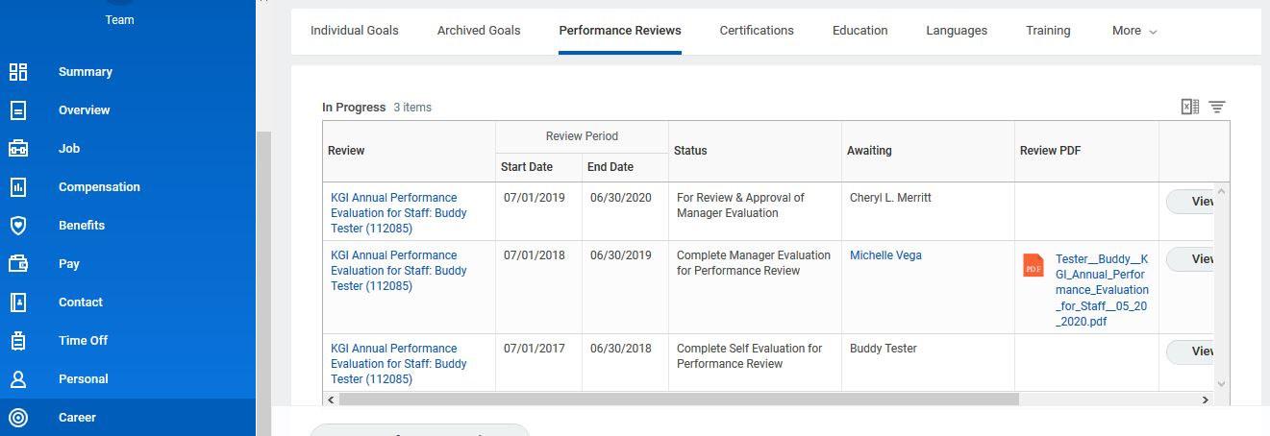


How to Access & Print the Evaluation Once Submitted

Slide 11


