Slide 1

Employee Self-Evaluation Training
Presented By:
Human Resources

Slide 2

Objectives
Overview: Performance Evaluation Process
Benefits of a performance review
Preparing for your Annual Self-Evaluation
Writing your Self-Evaluation
Review of Competencies & Performance Ratings
Workday Demonstration: How to access, complete, and submit your self-evaluation.
Q & A

Slide 3
Overview: Performance Evaluation Process
Review Period
  July 1, 2019 – June 30, 2020
Should I expect an Annual Evaluation if I was hired less than 12 months ago?
  90 Day Evaluation/Annual Evaluation
Is there anything I need to do to prepare?
  Self-Evaluation, Deadline: June 8, 2020
Communication of Evaluation
  When will this take place? Prior to July 1, 2020

Slide 4
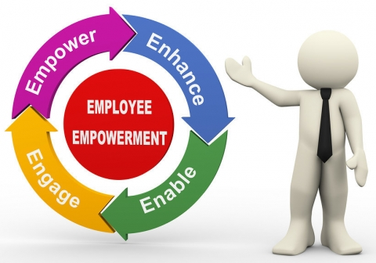
Benefits of a Performance Review
Provides guidance, recognition, and constructive feedback
  Opportunity to discuss ways to grow performance
  Recognize accomplishments
Helps individuals understand their role in their department and the Institution
Creates an environment for collaboration and open communication
Improves:
    Morale
    Behavior
    Performance
If done correctly, can encourage, motivate and reenergize individuals

Slide 5
Preparing for your Self-Evaluation
Utilize current and previous performance evaluations
Review goals, expectations, and projects
Is your job description accurate?
Have your professional development needs changed from the previous year?
Tell your story

Slide 6

Writing Your Self-Evaluation
  Provide specific examples of how you achieved established goals.
  Note areas where you took initiative and made improvements.
  Discuss how your contributions impacted the department and or Institutional goals.
  Explain how you enhanced your skills and capabilities.

Slide 7
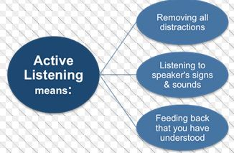
Annual Evaluation Meeting
Be open to feedback and receptive to new ideas
Give your feedback and ask questions
Engage in active listening
Stay involved in the discussion
Ensure that you understand the goals for the coming review period

Slide 8
After the Evaluation Meeting
Review the Evaluation
  Get clarification and submit comments.
  Schedule a follow up meeting, if needed.
Review Evaluation throughout the year
  Regularly review performance goals in to assess your progress.
  Clarify and make changes to goals as needed, especially if goals change during the year.
  Keep records of projects, accomplishments, feedback.

Slide 9
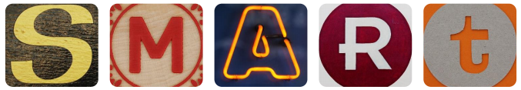
SMART Goals
SPECIFIC Who, What, Where, When, Why Define the goal as much as possible with no ambiguous language. | MEASURABLE From and To Can you track progress and measure the outcome? How will I know when my goal is reached? | ATTAINABLE How Is the goal reasonable enough to be accomplished? | RELEVANT Worthwhile Is each goal consistent with other goals you have established-both immediate and long term? | TIMELY When Your objective should include a time limit whenever possible. “I will complete this step by [date].”

Slide 10
Examples of SMART Goals
I will increase my marketing efforts in doing speaking engagements from two times per year to one time per month during the 2020-2021 fiscal year.
By January 1, 2021, complete an advanced Excel training course to upgrade my skills so I can prepare budget reconciliation reports with an analysis of trends and variances to help keep expenditures within budgeted limits.
By June 30, 2021, help develop and participate in cross‐training for the office assistant team to learn procedures across all units so that all critical functions are covered during absences.
Plan and execute five student events this year with 15-plus attendees per event and 80% or higher satisfied/very satisfied response on content.

Slide 11
Explanation of Ratings
HIGHLY EFFECTIVE | SUCCESSFUL AND EFFECTIVE | SOME IMPROVEMENT REQUIRED/SOME SUCCESS | SIGNIFICANT IMPROVEMENT REQUIRED
High quality of work are widely recognized. The majority of performance outcomes routinely and consistently exceed defined expectations, producing important and impactful results for the department and/or Institute through planning, execution and creativity. Projects and objectives are completed in a manner that expands the scope and impact of the assignment. | The staff is successful in performing the majority of job responsibilities and makes a solid, reliable and meaningful contribution to the department and/or Institute. | While the staff’s performance is effective in some areas, there are other areas in which performance is inconsistent and/or falls below established expectations. | Performance is not acceptable in critical areas of the job and falls below minimum expectations. Significant improvement is needed. A performance development plan is recommended that defines performance objectives and strategies for achieving success.

Slide 12
New Performance Factors
JOB KNOWLEDGE | Understands and applies processes and technical skills required for the position; stays up-to-date on best practices and trends as applicable to the department and/or position.
PROBLEM SOLVING & DECISION MAKING | Identifies and responds to problems quickly; anticipates potential problems and takes corrective action; conducts thorough examination of the problem and identifies and evaluates the most appropriate solutions; develops tools to measure outcomes; evaluates outcomes and solves problems; reports problems to management when necessary; makes decisions in a timely manner; decisions are consistent and clear.
INNOVATION | Exhibits creativity and innovation when contributing to organizational and individual objectives. Thinks expansively by combining ideas in unique ways or making connections between disparate ideas. Targets important areas for innovation and develops solutions that address meaningful work issues. Creates a work environment that encourages creative thinking and innovation. Adapts best practices and processes to their organizational area.
DELIVERING RESULTS | Improving products and services, while holding self and others accountable. Finds or creates ways to measure performance against goals. Identifies and pursues desired outcomes for projects and meetings. Continues to work toward achievement of goals in the face of obstacles. Shows appropriate level of effort, persistence, and time commitment to achieve goals.
INTERPERSONAL RELATIONS | Respects and values the contributions of staff, stakeholders and customers. Builds positive and respectful working relationships within and outside of the department. Creates an environment that fosters a high level of interaction and exchange of ideas. Promotes a team environment and sense of community. Demonstrates sensitivity and appreciation for diverse backgrounds. Handles conflict resolution and crises without losing efficiency or composure.

Slide 13
Performance Factors For Supervisors
PEOPLE DEVELOPMENT | Supervises and trains employees; sets goals, objectives, and expectations; gives encouragement and recognition; plans employee development activities; provides clear and timely feedback.
PLANNING & ORGANIZING | Identifies and develops departmental goals and objectives, the strategies needed to achieve those goals and objectives, and the plans to achieve them; executes, monitors, and evaluates progress towards meeting goals and re-strategizes as necessary; sets priorities and deadlines; delegates; flexible in changing goals, objectives, and plans as necessary.
CONFLICT MANAGEMENT | Recognizes differences of opinion and looks for win-win solutions. Uses appropriate interpersonal styles and methods to reduce tension or conflict between two or more people. Finds agreement on issues and follows through on implementation.

Slide 14

Demonstration
Completing your Self-Evaluation in Workday

Slide 15
Performance Evaluation Timeline
Self-Evaluations will be launched in Workday on Tuesday, May 26 to all staff.
Self-Evaluations to be submitted to Supervisors by Monday, June 8.
Supervisors to communicate Performance Evaluations by Tuesday, June 30.

Slide 16


