Slide 1

How to Prepare for a Useful Performance Review
Presented By:
Human Resources

Slide 2
Objectives
Guide to Performance Management
Benefits of Effective Performance Management
How Best to Analyze & Rate Job Performance
Communicating an Effective Evaluation
Supporting Throughout The Year
Employee Recognition
Planning for the Following Year
Examples of SMART goals
Review of Competencies & Explanation of Ratings
Workday Demonstration: How to complete a Staff Evaluation
Q & A

Slide 3

Important Dates To Remember
Self-Evaluations will be launched in Workday on Tuesday, May 26 to all staff.
Self-Evaluations to be submitted to Supervisors by Monday, June 8.
Performance Evaluations to be completed and communicated to staff by Wednesday, July 1.

Slide 4
Guide to Performance Management
Most employees want to be successful contributors. They want to know what is expected of them and how they can most effectively achieve those expectations. As a supervisor, it is your job to:
Clearly communicate expectations.
Provide employees with the tools, training, and information they need to succeed.
Offer regular, timely, and constructive feedback.
Be reasonable and fair when evaluating performance.
Recognize successes and achievements.
Address performance issues in a proactive and timely manner in order to resolve them before they become significant.

Slide 5
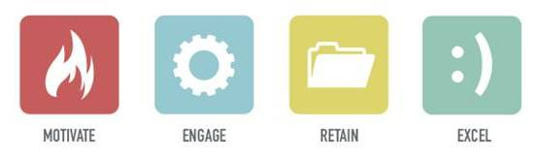
Benefits of Effective Performance Management
Motivate and engage employees.
Increase retention of good employees.
Reduce costs related to recruiting and training of
new employees.
Less time dealing with corrective action issues.
Positive reputation as a great place to work.

Slide 6

How Best to Analyze & Rate Job Performance
Utilize the self-evaluation.
Is the Job description accurate? JD’s should be used to judge performance,
Balance. Focus on strengths and areas for opportunity surrounding job performance.
Are individual, departmental, and institutional goals being met? List specific examples.
Solicit feedback from colleagues who have worked closely with the staff member.
If a staff member is not meeting expectations, a “false positive” evaluation is a dangerous document

Slide 7
Communicating an Effective Evaluation
Create a sincere, open, and safe environment.
Establish the purpose of the discussion.
  Review overall job requirements & responsibilities.
  Review the performance objectives and goals established during the last performance evaluation.
Balance praise and areas for improvement.
  Provide recognition.
  Address areas of performance where improvements are needed.
Ask for employee’s views on problems, suggestions for change, improvements, etc.
  Be a good listener.
Summarize the meeting, review goals/objectives, and gather a mutual understanding and agreement. End things on a positive note!

Slide 8
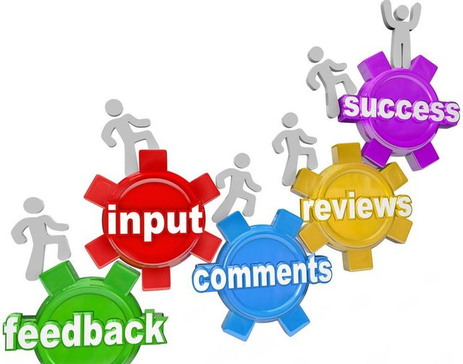
Supporting Throughout the year
A lot can happen in a year — for better or worse — so proactively supporting your employee in their goals can make all the difference in their work performance.
Stay Connected
Collaborate
Address Performance Issues Early
Revise goals, if needed

Slide 9

Employee Recognition
Employee satisfaction and commitment increases when employees:
Are recognized for their achievements
Know that their contributions matter to the Institution
At any time, you can boost employee engagement by recognizing the good work of your staff. Recognition can be awarded individually or collectively, formally or informally, publicly or privately.
Recognition is most effective when it takes place on a regular
basis and in a variety of different ways.

Slide 10
Planning For The Upcoming Year
Designing an employee’s goals should be a joint effort between you and the employee. Allow the employee a voice in their own performance management.
Set Goals:
Set goals with not for the employee. Employees who help set their own goals are more motivated to achieve them.
Use the SMART formula for setting goals:
Specific, Measurable, Achievable, Relevant, Time-bound.
Tie individual goals to departmental goals. Doing so helps the employee see the importance of their own work and increases their job satisfaction.
Assess the employee’s competencies. Does the employee need to develop any skills or knowledge to successfully perform their job?
Consider the employee’s long-range professional goals. Do this year’s goals help the employee reach their long-range goals?
Notes:
Encourage them to advocate for their own professional growth.

Slide 11
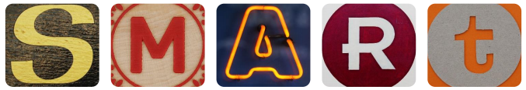
SMART Goals
SPECIFIC Who, What, Where, When, Why Define the goal as much as possible with no ambiguous language. | MEASURABLE From and To Can you track progress and measure the outcome? How will I know when my goal is reached? | ATTAINABLE How Is the goal reasonable enough to be accomplished? | RELEVANT Worthwhile Is each goal consistent with other goals you have established-both immediate and long term? | TIMELY When Your objective should include a time limit whenever possible. “I will complete this step by [date].”

Slide 12
Examples of SMART Goals
I will increase my marketing efforts in doing speaking engagements from two times per year to one time per month during the 2019-2020 fiscal year.
By January 1, 2020, complete an advanced Excel training course to upgrade my skills so I can prepare budget reconciliation reports with an analysis of trends and variances to help keep expenditures within budgeted limits.
By June 30, 2020, help develop and participate in cross‐training for the office assistant team to learn procedures across all units so that all critical functions are covered during absences.
Plan and execute five student events this year with 15-plus attendees per event and 80% or higher satisfied/very satisfied response on content.

Slide 13
Explanation of Ratings
HIGHLY EFFECTIVE | High quality of work are widely recognized. The majority of performance outcomes routinely and consistently exceed defined expectations, producing important and impactful results for the department and/or Institute through planning, execution and creativity. Projects and objectives are completed in a manner that expands the scope and impact of the assignment.
SUCCESSFUL AND EFFECTIVE | The staff is successful in performing the majority of job responsibilities and makes a solid, reliable and meaningful contribution to the department and/or Institute.
SOME IMPROVEMENT REQUIRED/SOME SUCCESS | While the staff’s performance is effective in some areas, there are other areas in which performance is inconsistent and/or falls below established expectations.
SIGNIFICANT IMPROVEMENT REQUIRED | Performance is not acceptable in critical areas of the job and falls below minimum expectations. Significant improvement is needed. A performance development plan is recommended that defines performance objectives and strategies for achieving success.

Slide 14
Performance Factors
JOB KNOWLEDGE | Understands and applies processes and technical skills required for the position; stays up-to-date on best practices and trends as applicable to the department and/or position.
PROBLEM SOLVING & DECISION MAKING | Identifies and responds to problems quickly; anticipates potential problems and takes corrective action; conducts thorough examination of the problem and identifies and evaluates the most appropriate solutions; develops tools to measure outcomes; evaluates outcomes and solves problems; reports problems to management when necessary; makes decisions in a timely manner; decisions are consistent and clear.
INNOVATION | Exhibits creativity and innovation when contributing to organizational and individual objectives. Thinks expansively by combining ideas in unique ways or making connections between disparate ideas. Targets important areas for innovation and develops solutions that address meaningful work issues. Creates a work environment that encourages creative thinking and innovation. Adapts best practices and processes to their organizational area.
DELIVERING RESULTS | Improving products and services, while holding self and others accountable. Finds or creates ways to measure performance against goals. Identifies and pursues desired outcomes for projects and meetings. Continues to work toward achievement of goals in the face of obstacles. Shows appropriate level of effort, persistence, and time commitment to achieve goals.
INTERPERSONAL RELATIONS | Respects and values the contributions of staff, stakeholders and customers. Builds positive and respectful working relationships within and outside of the department. Creates an environment that fosters a high level of interaction and exchange of ideas. Promotes a team environment and sense of community. Demonstrates sensitivity and appreciation for diverse backgrounds. Handles conflict resolution and crises without losing efficiency or composure.

Slide 15
Performance Factors For Supervisors
PEOPLE DEVELOPMENT | Supervises and trains employees; sets goals, objectives, and expectations; gives encouragement and recognition; plans employee development activities; provides clear and timely feedback.
PLANNING & ORGANIZING | Identifies and develops departmental goals and objectives, the strategies needed to achieve those goals and objectives, and the plans to achieve them; executes, monitors, and evaluates progress towards meeting goals and re-strategizes as necessary; sets priorities and deadlines; delegates; flexible in changing goals, objectives, and plans as necessary.
CONFLICT MANAGEMENT | Recognizes differences of opinion and looks for win-win solutions. Uses appropriate interpersonal styles and methods to reduce tension or conflict between two or more people. Finds agreement on issues and follows through on implementation.

Slide 16

Demonstration
Completing a Staff Evaluation in Workday

Slide 17
Evaluation Approval Process in Workday
Employee Self-Evaluation
Manager Evaluation
HR Approval
Manager Meets in Person with Employee
Manager Confirms Meeting with Employee
Employee Acknowledges Review
Manager Acknowledges Review
Process is Complete
Next Level Manager
Approval

Slide 18


