Slide 1

How to Complete an Annual Performance Evaluation in Workday
Presented By:
Human Resources

Slide 2
Objectives
Introduction to the NEW Performance Competencies
Explanation of Performance Evaluation Ratings
Review of Evaluation Approval Process in Workday
Workday Demonstration:
  How to complete a Staff Evaluation
  Review of staff goals
  How to access & print an evaluation once submitted
Communicating an Effective Evaluation
Q & A

Slide 3

Important Dates To Remember
Review Period is based on a 7/1/2019 through 6/30/2020 period.
Self-Evaluations will be launched in Workday on Tuesday, May 26 to all staff.
Self-Evaluations to be submitted to Supervisors by Monday, June 8.
Performance Evaluations to be completed and communicated to staff by Wednesday, July 1.

Slide 4
New Performance Factors
JOB KNOWLEDGE | Understands and applies processes and technical skills required for the position; stays up-to-date on best practices and trends as applicable to the department and/or position.
PROBLEM SOLVING & DECISION MAKING | Identifies and responds to problems quickly; anticipates potential problems and takes corrective action; conducts thorough examination of the problem and identifies and evaluates the most appropriate solutions; develops tools to measure outcomes; evaluates outcomes and solves problems; reports problems to management when necessary; makes decisions in a timely manner; decisions are consistent and clear.
INNOVATION | Exhibits creativity and innovation when contributing to organizational and individual objectives. Thinks expansively by combining ideas in unique ways or making connections between disparate ideas. Targets important areas for innovation and develops solutions that address meaningful work issues. Creates a work environment that encourages creative thinking and innovation. Adapts best practices and processes to their organizational area.
DELIVERING RESULTS | Improving products and services, while holding self and others accountable. Finds or creates ways to measure performance against goals. Identifies and pursues desired outcomes for projects and meetings. Continues to work toward achievement of goals in the face of obstacles. Shows appropriate level of effort, persistence, and time commitment to achieve goals.
INTERPERSONAL RELATIONS | Respects and values the contributions of staff, stakeholders and customers. Builds positive and respectful working relationships within and outside of the department. Creates an environment that fosters a high level of interaction and exchange of ideas. Promotes a team environment and sense of community. Demonstrates sensitivity and appreciation for diverse backgrounds. Handles conflict resolution and crises without losing efficiency or composure.

Slide 5
Previous Performance Factors
Quality of Work and/or Productivity
Consider your accuracy, thoroughness, efficiency and timeliness. Consider the extent in which projects are well conceived, analyzed and implemented.
Flexibility
Consider your performance under pressure, the handling of multiple assignments, adaptability and your ability to manage conflicting priorities.
Continuous Improvement
Enhance creativity, innovation and change. Suggest improvement over what is presently done or used. Present ideas that move things in the direction of solution potential for sustained success or positive change.
Accountability
Honor commitments and dedication to delivering timely results. Problem solving – Identify problems, involve others in seeking solutions. Decision Making – Making clear, consistent, decisions; act with integrity in all decision-making; distinguish relevant from irrelevant information.
Interpersonal Relations, Communication, Collaboration
Consider the degree you use tact and diplomacy in developing effective working relationships with individuals and teams; share pertinent information in order to help others; actively listen and demonstrate an acceptance of individual differences.
Customer Service
Passionate about providing high quality customer service and valuing the importance. Understanding the needs of the customer; customer service focused.
Professionalism
Demonstrate respect for KGI’s Code of Conduct by adhering to KGI and department policies, procedures and applicable laws and regulations; use work time appropriately and avoid real and perceived conflicts of interests; maintain composure in high-stress situations; present professional demeanor in communications and work quality.
Leadership & Staff Development
Consider the extend to which the supervisor provides staff guidance and opportunities for development and advancement; builds an environment that supports collaboration, teamwork, and respect for and acceptance of individual differences; and promotes quality customer service.
Performance Management
Consider the extent to which the supervisor is effective in setting performance standards and expectations, giving ongoing and timely feedback and coaching, and resolving performance problems constructively.

Slide 6
Performance Factors For Supervisors
PEOPLE DEVELOPMENT | Supervises and trains employees; sets goals, objectives, and expectations; gives encouragement and recognition; plans employee development activities; provides clear and timely feedback.
PLANNING & ORGANIZING | Identifies and develops departmental goals and objectives, the strategies needed to achieve those goals and objectives, and the plans to achieve them; executes, monitors, and evaluates progress towards meeting goals and re-strategizes as necessary; sets priorities and deadlines; delegates; flexible in changing goals, objectives, and plans as necessary.
CONFLICT MANAGEMENT | Recognizes differences of opinion and looks for win-win solutions. Uses appropriate interpersonal styles and methods to reduce tension or conflict between two or more people. Finds agreement on issues and follows through on implementation.

Slide 7
Performance Evaluation Ratings
HIGHLY EFFECTIVE | High quality of work are widely recognized. The majority of performance outcomes routinely and consistently exceed defined expectations, producing important and impactful results for the department and/or Institute through planning, execution and creativity. Projects and objectives are completed in a manner that expands the scope and impact of the assignment.
SUCCESSFUL AND EFFECTIVE | The staff is successful in performing the majority of job responsibilities and makes a solid, reliable and meaningful contribution to the department and/or Institute.
SOME IMPROVEMENT REQUIRED/SOME SUCCESS | While the staff’s performance is effective in some areas, there are other areas in which performance is inconsistent and/or falls below established expectations.
SIGNIFICANT IMPROVEMENT REQUIRED | Performance is not acceptable in critical areas of the job and falls below minimum expectations. Significant improvement is needed. A performance development plan is recommended that defines performance objectives and strategies for achieving success.

Slide 8
Evaluation Approval Process in Workday
Employee Self-Evaluation
Next Level Manager Approval
HR Review/Approval
Manager Meets in Person with Employee
Manager Confirms Meeting with Employee
Employee Acknowledges Review
Manager Acknowledges Review
Process is Complete
Manager Evaluation
If the Next Level up is the President, this step will be skipped.

Slide 9
Demonstration
Completing a Staff Evaluation in Workday

Slide 10
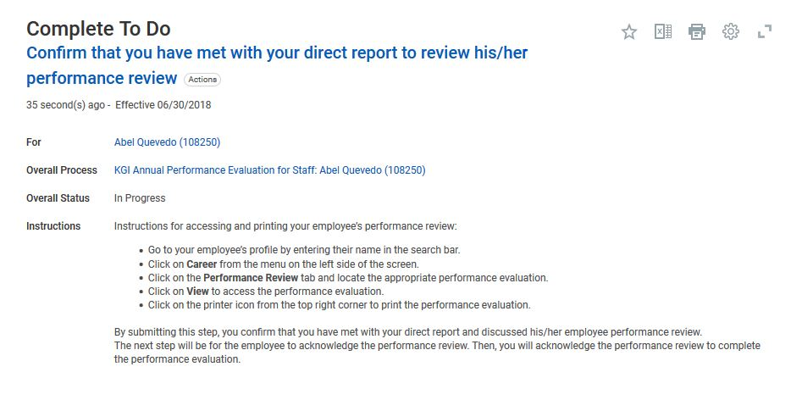

Manager TO DO Step

Slide 11

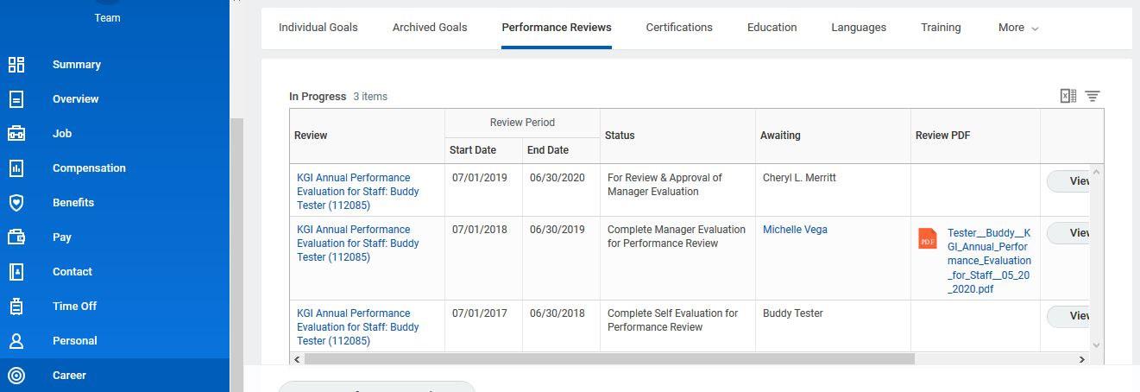

How to Access & Print the Evaluation Once Submitted

Slide 12
Communicating an Effective Evaluation
Create a sincere, open, and safe environment.
Establish the purpose of the discussion.
  Review overall job requirements & responsibilities.
  Review the performance objectives and goals established during the last performance evaluation.
Balance praise and areas for improvement.
  Provide recognition.
  Address areas of performance where improvements are needed.
Ask for employee’s views on problems, suggestions for change, improvements, etc.
  Be a good listener.
Summarize the meeting, review goals/objectives, and gather a mutual understanding and agreement. End things on a positive note!

Slide 13


