Slide 1
The New Normal: Life After COVID-19

Slide 2
What to Expect
Welcome/Learning Points
Our Daily Life
Considerations for the Senior Population
Considerations for Children
Considerations for Couples
Considerations for Singles
Mitigating the Risk of Resurgence
Returning to the Outside World
Notes:
2

Slide 3
Learning Points
Assess your current daily life and consider the changes that are needed as you return
Review the skills that have been helpful during this time, using them as you go forward
Become aware of different perspectives of children, seniors, couples etc.
Notes:
3

Slide 4
Our Daily Life
Changes will be made
Family decisions will have to be discussed and made
Previous functions may or may not be rescheduled
Living with this “new reality”
Caution when making plans for the future
Have patience for the process
Practical things to carry with you: Mask, sanitizer, mini-soap

Slide 5
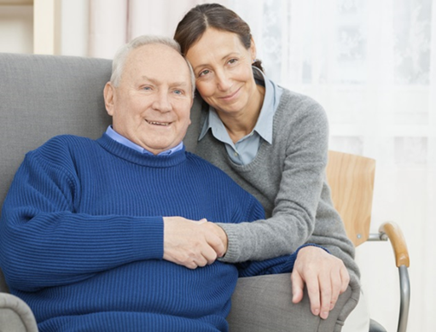
Considerations for the Senior Population
Potentially has lost more friends than the rest of the population
Could have brought more fears of the reality of end of life than prior to the pandemic
May have the most difficulty of overcoming the fear of socializing again
May have missed seeing their families

Slide 6
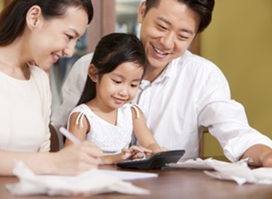

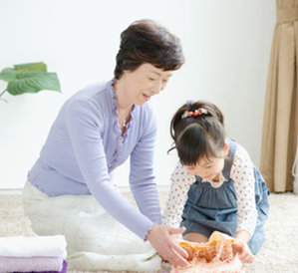
Considerations for Children
Children tend to be the most resilient
Will bounce back quickly and move on
Parents need to let them have their feelings and discuss their emotions
Most will not need to discuss the pandemic in any detail

Slide 7
Considerations for Couples
A major change as they were used to be together 24/7
Allow some time to breathe
Get used to the “new” routine
Communicate, communicate, communicate

Slide 8
Considerations for Single
How to return to the dating world?
How did the quarantine affect you as a single person?
What were the learning take-a-ways?
What changes in your social life can you (should you) make?

Slide 9
Mitigating the Risk of Resurgence
We may still need to practice social distancing:
  To shake hands or not?
  To hug or not?
  To kiss hello or not?
  Hesitation to go into crowds
  Keep focus on managing risks
  When to visit higher risk people

Slide 10
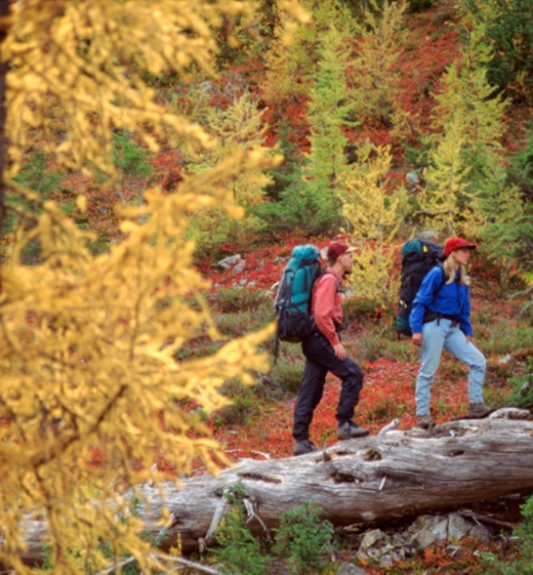
Returning to the Outside World
Be mindful of over shopping
Be mindful of overspending
Return to the world of investing
Allow yourself the time to re-enter slowly
Return with an increased focus on safety
  How to catch/avoid the virus
  Traveling (via air, subway, train, bus etc.)
  Navigating crowds

Slide 11
Thanks for attending today’s presentation.
The New Normal: Life After COVID-19

